Slide 1
Tradeoffs in achieving food and nutrition security at global and regional scales
Keith Wiebe Senior Research Fellow International Food Policy Research Institute
With Global Futures & Strategic Foresight colleagues from AfricaRice, Bioversity, CIAT, CIFOR, CIMMYT, CIP, ICARDA, ICRAF, ICRISAT, IFPRI, IITA, ILRI, IRRI, IWMI, WorldFish, and other partners
Impacts World 2017
Potsdam, Germany
12 October 2017

Slide 2







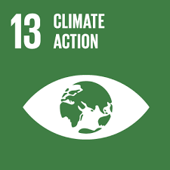

Modeling alternative futures for agriculture: biophysical and socioeconomic drivers and effects
Poverty
Climate
Biophysical
Economic
General circulation models (GCMs)
Global gridded crop models (GGCMs)
Global economic models
Δ Temp
Δ Precip
…
Δ Yield
(biophys)
Δ Area
Δ Yield
Δ Cons.
Δ Trade
Hunger
RCPs
SSPs
Environment
Adapted from Nelson et al., Proceedings of the National Academy of Sciences (2014)
Notes:
The modeling framework uses results from general circulation (climate) models as inputs to crop models and then economic models, under a range of climate and socioeconomic assumptions.

Slide 3

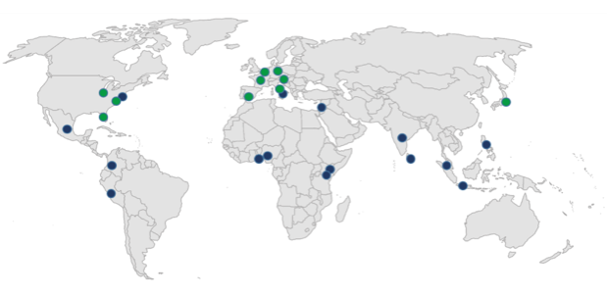
Partners in Global Foresight modeling
AgMIP Global Economics
  IFPRI, PIK, GTAP, Wageningen, EC/JRC, USDA/ERS, IIASA, FAO, OECD, UFL, NIES, …
Global Futures & Strategic Foresight – 15 CGIAR centers
  AfricaRice, Bioversity, CIAT, CIFOR, CIMMYT, CIP, ICARDA, ICRAF, ICRISAT, IFPRI, IITA, ILRI, IRRI, IWMI, WorldFish
Notes:
IFPRI’s IMPACT model is continuously updated and improved in collaboration with partners in all 15 CGIAR centers as well as other global modeling groups through AgMIP.

Slide 4
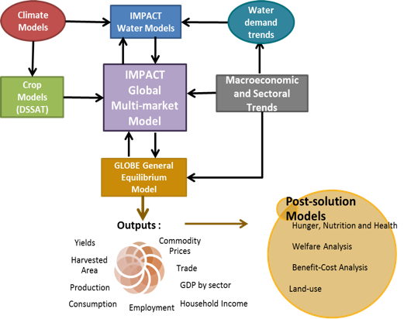
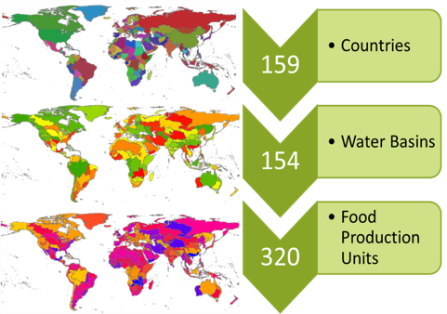
IFPRI’s IMPACT system of models
Exploring alternative climate and investment futures
Source: Robinson et al. (2015) "The International Model for Policy Analysis of Agricultural Commodities and Trade (IMPACT); Model description for version 3". IFPRI Discussion Paper. International Food Policy Research Institute: Washington, DC.
Notes:
In particular we use IFPRI’s IMPACT system of economic and water models, in conjunction with climate and crop models.

Slide 5
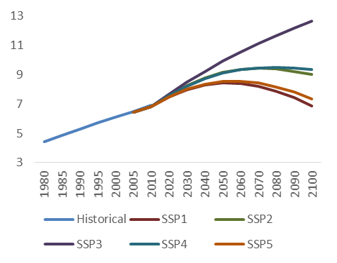
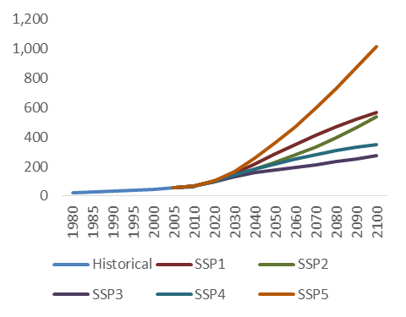
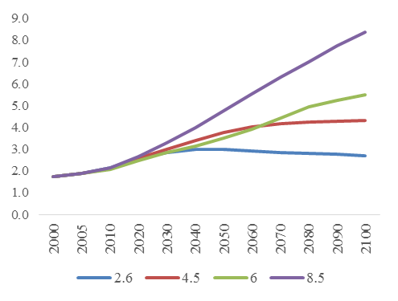
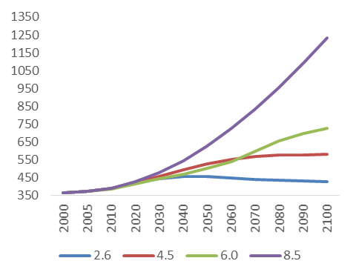
Reference socioeconomic and climate drivers
Population (billion)
GDP (trillion USD, 2005 ppp)
Shared Socioeconomic Pathways (SSPs)
Representative Concentration Pathways (RCPs)
This work uses “middle-of-the-road” SSP2 and
rapid climate change RCP 8.5 as the reference case.
Radiative forcing
(W/m²)
CO₂ equiv. (ppm)
Source: Downloaded from the RCP Database version 2.0.5 (2015). RCP 2.6: van Vuuren et al. 2006; van Vuuren et al. 2007. RCP 4.5: Clark et al. 2007; Smith and Wigley 2006; Wise et al 2009. RCP 6.0: Fujino et al 2006; Hijioka et al 2008. RCP 8.5: Riahi and Nakicenovic, 2007.

Slide 6
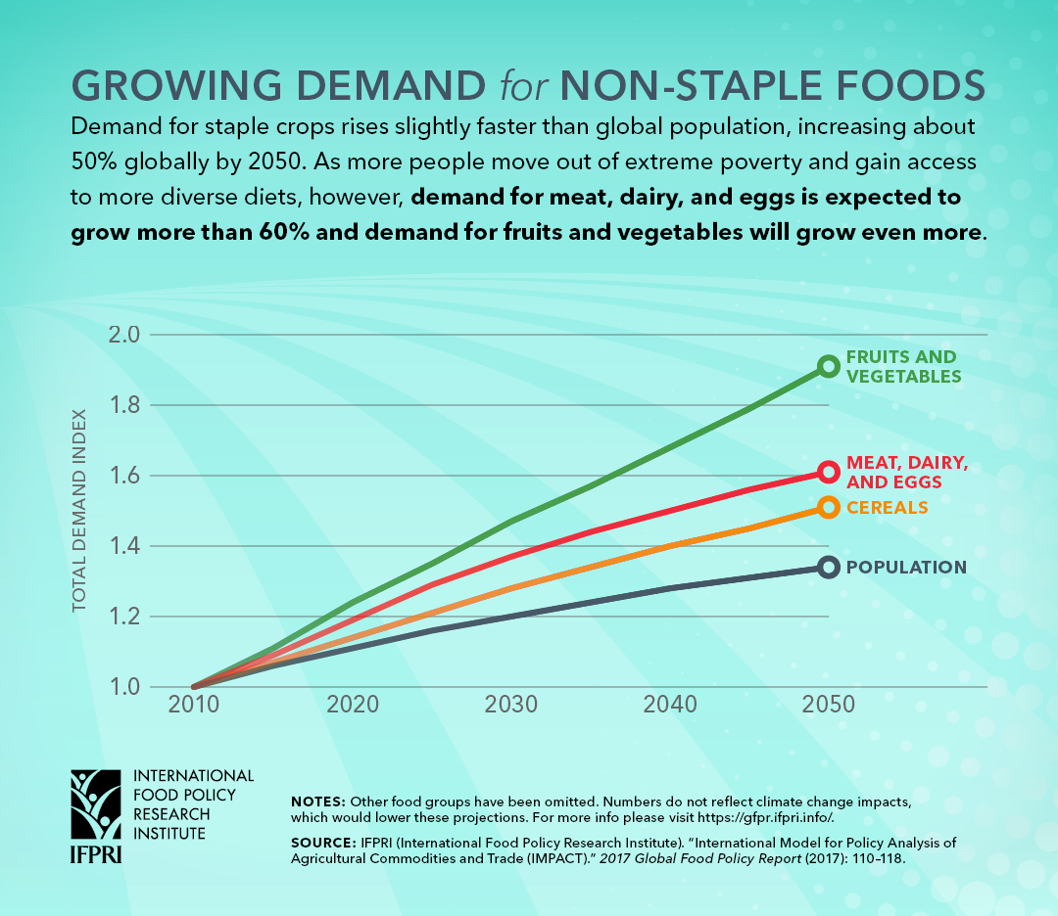
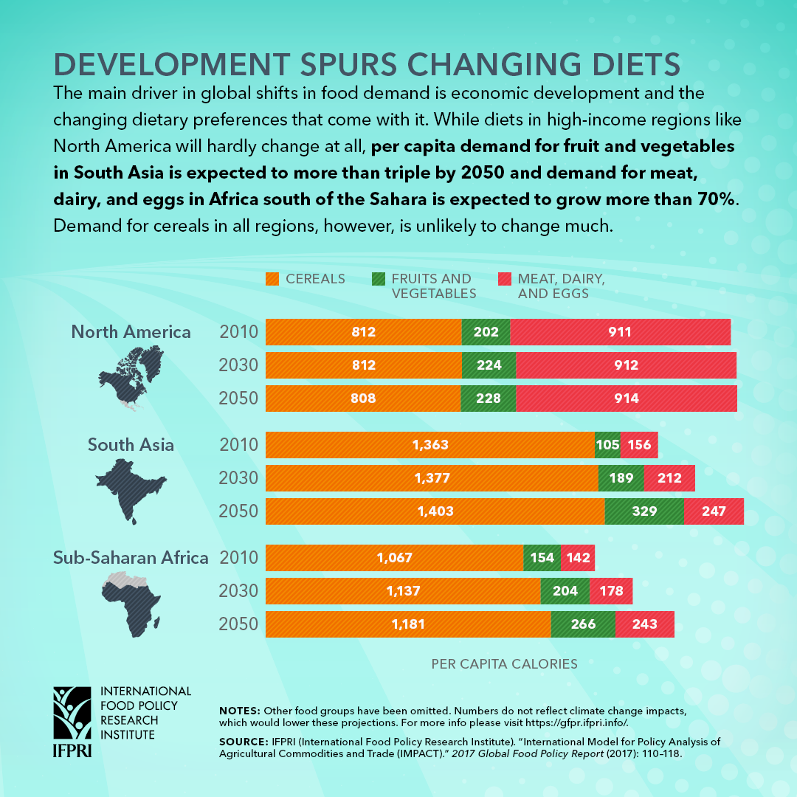
Changing patterns of demand

Slide 7
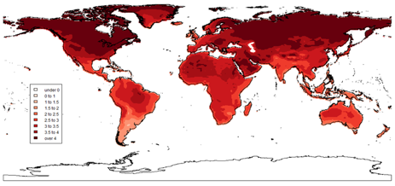
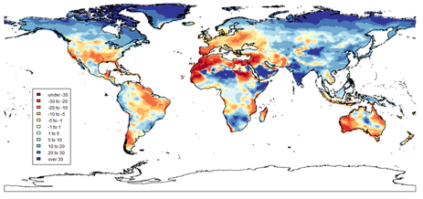
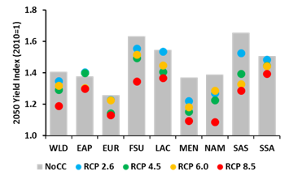
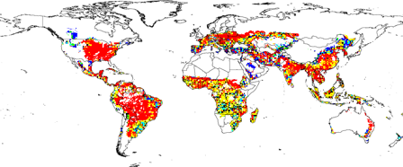

Estimating climate change impacts in 2050
The example of maize yields using HadGEM (RCP8.5), DSSAT, and IMPACT (SSP2)
Maximum temperature (°C)
Annual precipitation (mm)
Change in rainfed maize yields before economic adjustments
Change in rainfed maize yields after economic adjustments
Source: IFPRI, IMPACT version 3.2, November 2015
Notes:
Using rainfed maize as an example, we explore how changes in temperature and precipitation from the HadGEM GCM under RCP 8.5 affect yields, first holding other factors constant (using a DSSAT crop model), and then allowing prices and other economic factors to change (using the IMPACT model).

Slide 8
Average of 5 global economic models for coarse grains, rice, wheat, oilseeds & sugar
Climate change impacts in 2050
Source: Wiebe et al., Environmental Research Letters (2015)

Slide 9
Reference and alternative scenarios
Scenario Grouping | Scenario | Scenario Description
Reference | REF_HGEM | Reference scenario with RCP 8.5 future climate using HadGEM GCM
 | REF_IPSL | Alternative reference with RCP 8.5 future climate using IPSL GCM
 | REF_NoCC | Alternate reference with no climate change (constant 2005 climate)
Productivity Enhancement | MED | Medium increase in R&D investment across the CGIAR portfolio
 | HIGH | High increase in R&D investment across the CGIAR portfolio
 | HIGH+NARS | High increase in R&D investment across the CGIAR portfolio plus complementary NARS investments
 | HIGH+RE | High increase in R&D investment across the CGIAR portfolio plus increased research efficiency
 | REGION | Regionally-focused high increase in CGIAR R&D investments Targets the highest increases to South Asia and Sub-Saharan Africa with medium levels of increase in Latin America and East Asia
Improved Water Resource Management | IX | Investments to expand irrigation in the developing world
 | IX+WUE | Irrigation expansion plus increased water use efficiency
 | ISW | Investments to increase soil water holding capacity
Improved Infrastructure | RMM | Infrastructure improvements to improve market efficiency through the reduction of transportation costs and marketing margins
Comprehensive Investment | COMP | This comprehensive scenario is a combination of 4 scenarios: HIGH+RE; IX+WUE; ISW; and RMM
Source: Rosegrant et al. 2017

Slide 10
Tradeoffs and synergies under alternative scenarios
(percentage change relative to baseline in 2030 and 2050)
Scenario | Avg. Annual Cost | 2030 |  |  |  |  |  | 2050
 |  | SLO1 | SLO2 |  | SLO3 |  |  | SLO1 | SLO2 |  | SLO3
 |  | GDP | Ag Supply | Hunger | Water Use | GHG | Forest | GDP | Ag Supply | Hunger | Water Use | GHG | Forest
MED R&D | 1.4 | 0.7 | 1.4 | -6.5 | 0.0 | -5.5 | 0.03 | 1.9 | 2.7 | -9.3 | -0.2 | -15.4 | 0.13
HIGH R&D | 2.0 | 1.3 | 2.8 | -12.4 | -0.1 | -7.5 | 0.04 | 3.4 | 5.7 | -16.6 | -0.4 | -24.3 | 0.20
HIGH+NARS | 3.0 | 1.6 | 3.7 | -15.8 | -0.1 | -8.9 | 0.04 | 4.3 | 7.7 | -20.2 | -0.4 | -26.5 | 0.22
HIGH+RE | 2.0 | 2.6 | 6.4 | -24.4 | -0.2 | -12.7 | 0.06 | 4.2 | 7.5 | -20.0 | -0.4 | -26.9 | 0.22
REGION | 2.5 | 1.1 | 2.4 | -10.9 | -0.1 | -6.5 | 0.03 | 3.1 | 5.1 | -15.4 | -0.3 | -22.6 | 0.18
Irrig Exp | 3.5 | 0.1 | 0.1 | -1.3 | 2.6 | -1.8 | 0.01 | 0.2 | 0.2 | -1.1 | 2.9 | 0.7 | -0.01
IX+WUE | 8.1 | 0.4 | 0.9 | -4.5 | -7.2 | -1.9 | 0.01 | 0.5 | 0.9 | -2.7 | -7.5 | -0.2 | -0.01
ISWM | 4.6 | 0.2 | 0.5 | -2.1 | -1.5 | -0.5 | 0.00 | 0.5 | 0.9 | -3.0 | -2.9 | -1.1 | 0.01
RMM | 10.8 | 1.0 | 1.6 | -5.8 | 0.1 | 6.4 | -0.02 | 0.8 | 1.5 | -4.2 | 0.0 | 8.9 | -0.08
COMP | 25.5 | 4.1 | 9.8 | -30.6 | -9.0 | -11.5 | 0.07 | 5.7 | 11.5 | -24.4 | -11.0 | -25.4 | 0.22
Less Advantageous | Neutral | More Advantageous
Source: IFPRI, IMPACT model version 3.3 (Rosegrant et al. 2017)
Notes:
Results were explored across the scenarios (left-hand column) by different categories of indicators (SLO1 relating to poverty, SLO2 relating to food security and nutrition, and SLO3 relating to environmental sustainability), and over time (2030 and 2050).

Slide 11
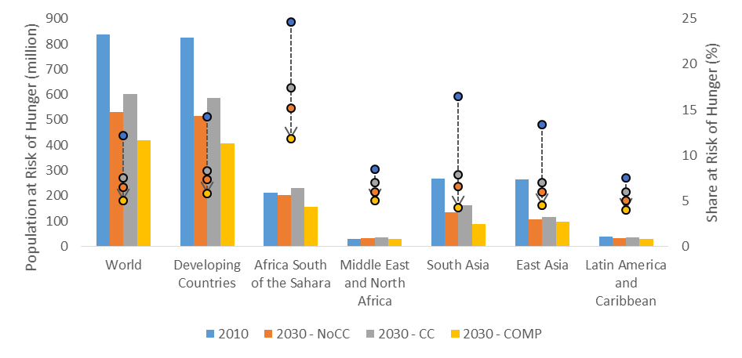
Hunger in 2030 by climate and investment scenario
(Bars showing numbers on the left axis, dots showing shares on the right axis)
Note: 2030-NoCC assumes a constant 2005 climate; 2030-CC reflects climate change using RCP 8.5 and the Hadley Climate Model, and 2030-COMP assumes climate change plus increased investment in developing country agriculture.
Source: IFPRI, IMPACT model version 3.3 (Rosegrant et al. 2017).
Notes:
The population at risk of hunger (left axis) is projected to decline globally to around 500 million by 2030 in the absence of climate change, but climate change will slow progress. Increased investment will offset the impact of climate change and reduce the global number to around 400 million. The share of population at risk of hunger (right axis) is projected to decline to 5% or less globally and in all regions except for Africa South of the Sahara.

Slide 12
Diet, nutrition, and health: Progress relative to WHO targets (baseline with climate change)
Note: 2050 results reflect climate change impacts simulated using RCP 8.5 and the Hadley Climate Model.
Source: IFPRI, IMPACT model version 3.3 (Rosegrant et al. 2017).
Notes:
Notes:
¹ WHO recommends a healthy diet should have at least 500 g/person/day of fruits and vegetables
² WHO recommends a healthy diet should have less than 30% of energy coming from fat
³ WHO recommends a healthy diet should have less than 10% of energy coming from sugar, with less than 5% being ideal
⁴ WHO recommends energy intake should correspond with activity levels, where 3,000 kcal/person/day and 2,400 kcal/person/day is the recommended for an active male and female respectively (20-35 years old)
Across these four targets we can see significant gains being achieved in increasing consumption of micronutrient rich fruits and vegetables, with all regions except for Africa South of the Sahara meeting the 500 g/person/day target by 2050. Calorie consumption also increases across all regions. However, this broad increase in food supply also comes with some negative consequences, with all regions consuming 10 percent or more of calories from sugar, with East Asia and Latin America nearing 30 percent of calories from fat.

Slide 13
Key findings
Population and income growth will drive growth in demand
Food security is projected to improve
Climate change will slow this progress
Important implications for nutrients, diets, and health

Slide 14


















Thank you

