Slide 1
Water Game

Slide 2
Context
Over-exploitation of water has resulted in water stress
Top-down regulations have limited impacts in influencing behaviour and water use
Managing groundwater is particularly challenging
Though a shared resource, groundwater is often perceived as a ‘private’ resource
Mobile nature ‘invisible’ to human eyes
Effective coordination at the local level can help in a more equitable and sustainable water use

Slide 3
Rainfall
Theory of Change
Watershed Management Programs
Water Harvesting
Groundwater Recharge
NGO Facilitation
*Process
Community Understanding
*Understanding
Community Groundwater Budgets
*Rules
Groundwater Use
* Behavior
Groundwater Level
*Environment
Other Factors Affecting Collective Action
Experimental Games
State Regulations on Wells
Crop Prices
State Policy on Energy
Conceptual model of factors affecting groundwater levels
(Adapted from ‘Playing games to save water: Collective action games for groundwater management in Andhra Pradesh, India. Ruth Meinzen-Dick, et.al. 2018)

Slide 4
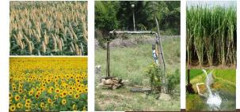
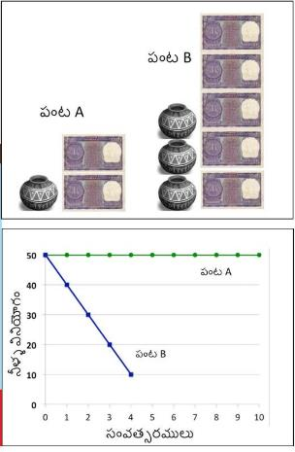
Design of the Game
Played with group of 5 Participants
Separate group for men and men
Optional: Players can be rotated
Common water source (well / borewell) with 50 units of water
Players need to select between two types of Crops
Crop A: Uses less water and fetches lower price in market
Crop B: Water intensive and fetches higher price in market
Based on the crop choices the water falls. In addition 2 units of water is deducted every year to take into account household use on drinking, cooking and other uses.
Every year there is also some water recharge

Slide 5
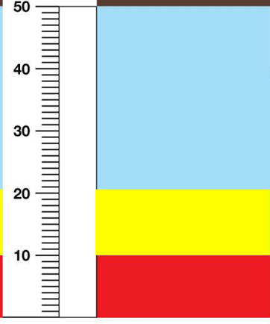
Design of the Game
Three zones –
Blue (sufficient water for irrigation),
Yellow (low water level and groundwater is contaminated, so the participants have to pay Rs.200 to get water from outside for household uses) and
Red (water is too low and its not possible to extract water and the game ends)
Two rounds:
Game 1: without communication (10 rounds or till the groundwater reaches the red zone; constant recharge of 7 units of water)
Game 2: with communication (1st three rounds with 7 units of recharge, 4th round onwards use a dice to determine recharge)

Slide 6
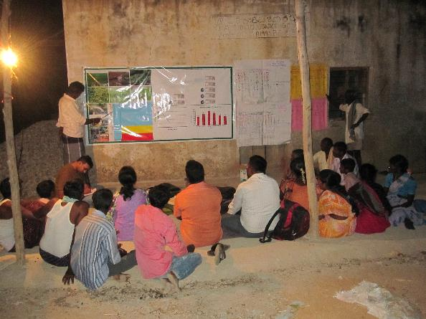
Community Debriefing
Mix group including women & men from different social and economic backgrounds
Triggering discussion around:
Interconnectedness between cropping patterns and groundwater use
How the game was played, what we learned and what we might do as a village?
Two ways:
Trend line exercise and game discussion
Game discussion and crop water budget

Slide 7
Preparing for the Game
Groundwater Game Checklist:
Groundwater Game Flexi (Ex: 5 feet x 4 feet)
Rope and strong tape to hang flexi up in the village
Groundwater Marker/ Flexi Strip for moving water level on flexi
Good double-sided sticky tape that will re-stick when water marker is moved
Crop Images: 3-4 options of local crops that use less water. 6 copies of each crop
Crop Images: 3-4 options of local water intensive crops. 6 copies of each crop
2 dice with the side with 6 dots covered, in the game, this represents 0.
5 Envelopes - one for each player to make their crop choice and receive money
200 Currency Notes or tokens representing money (this includes extras)
Blank Groundwater Record - enough spaces for up to 25 years total, or 12 years each game
Blank Groundwater Graphs
Crop Choice Records - 1 per game
Writing Pad for Crop Choice Record
Ink pen for Crop Choice Record
Assorted Colored Markers for Groundwater Record and Groundwater Graph - the best colors to use are: black, brown, red, blue, purple. (Orange and yellow are often hard to see)

Slide 8
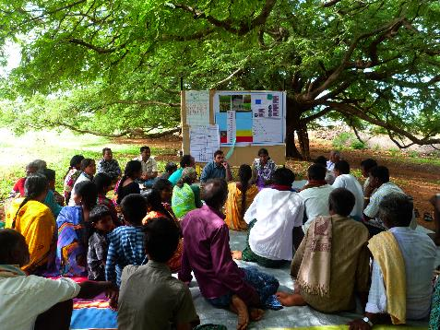
Organizing the Game
Understanding the local context (gender & power dynamics; cropping pattern; biophysical conditions – geology, soil type, forest cover, rainfall patterns)
Mobilizing the community and selection of participants (representation from different sections – caste/religion/age, village leaders / decision makers, borewell owners and users)
Selection of game site, timing and other logistics (common sites where everyone can participate - under a large shade tree, school room / community hall etc., select good time and date for game & debrief)

Slide 9
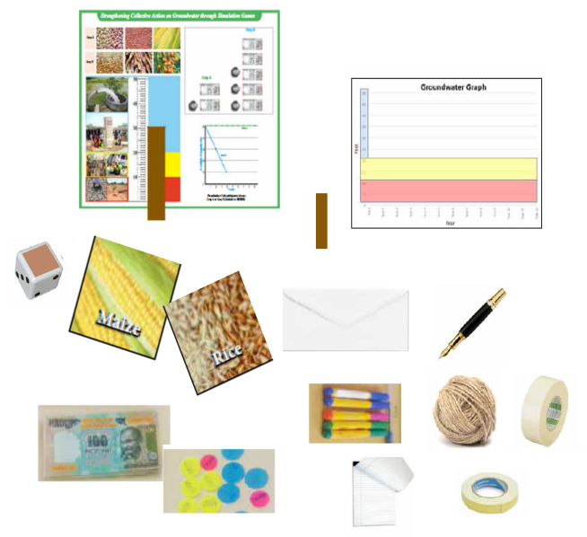
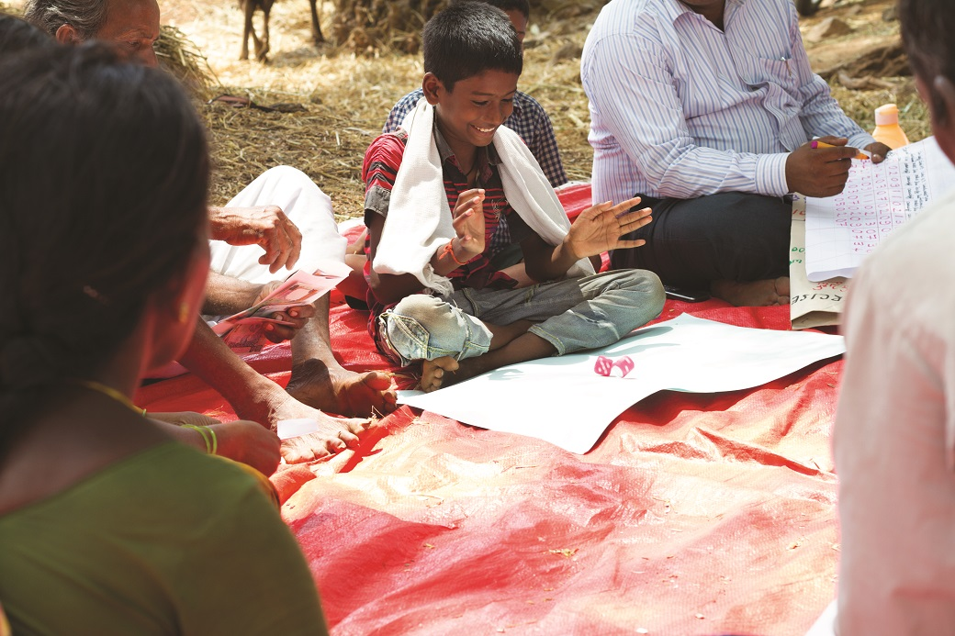
Let’s Play !

