Slide 1
Water Game Tool
24-Jun-2020

Slide 2
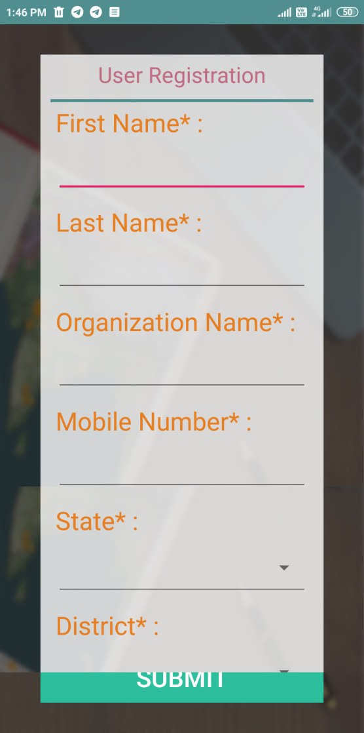
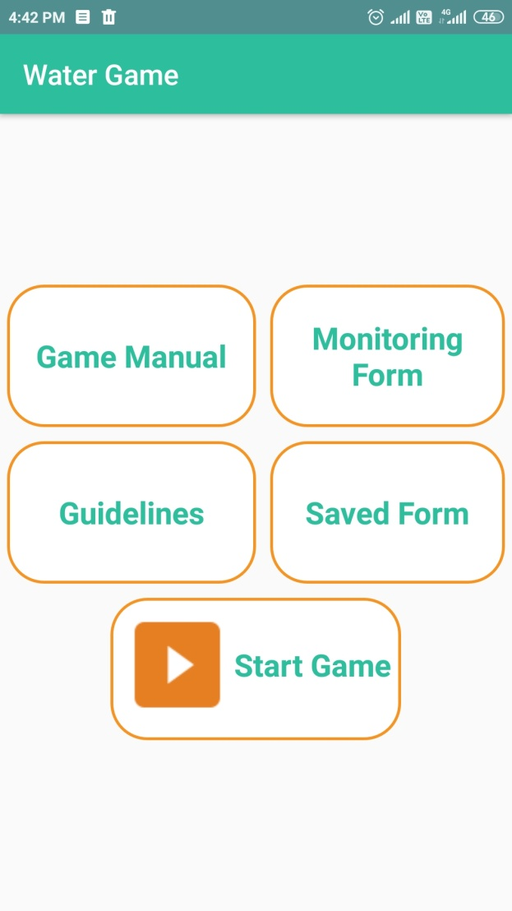
How to use Water Game Tool
User registration (One time only) No Internet is required after registration | Main screen

Slide 3
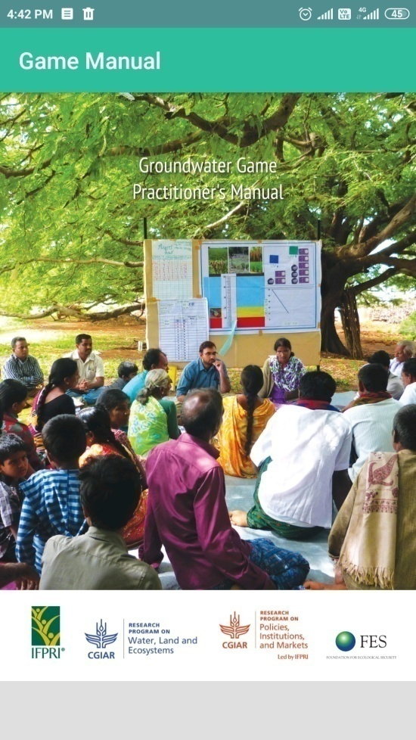
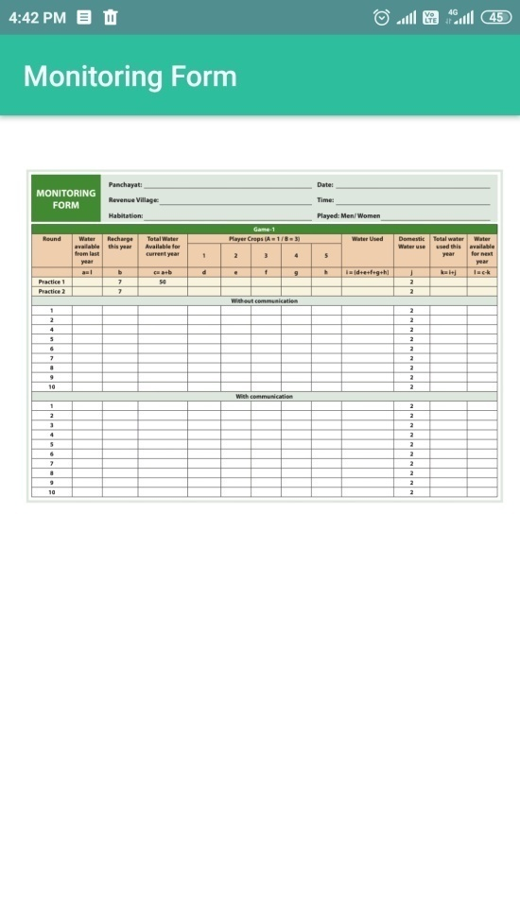
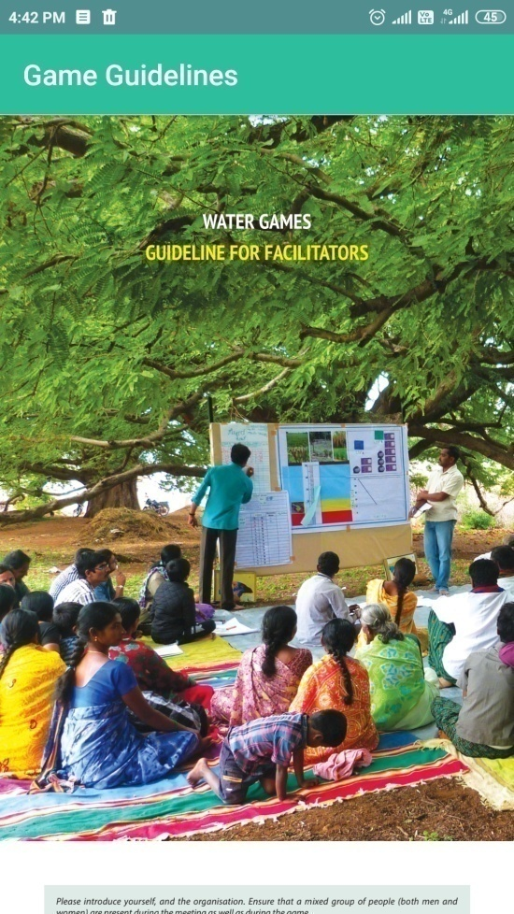
How to use Water Game Tool (Cont.)
Click Game Manual to view Game Manual document | Click Monitoring Form to display Monitoring form document | Click Guidelines to dislay guidelines document

Slide 4
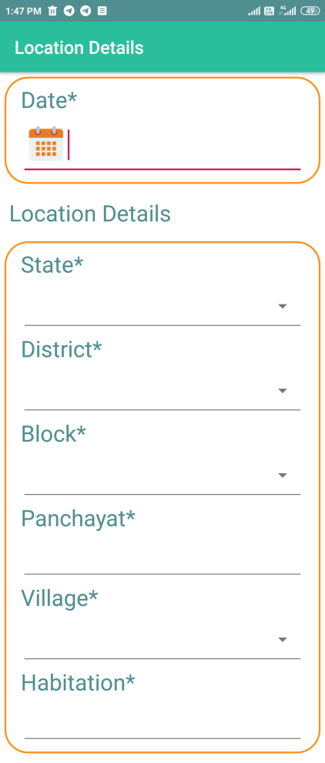
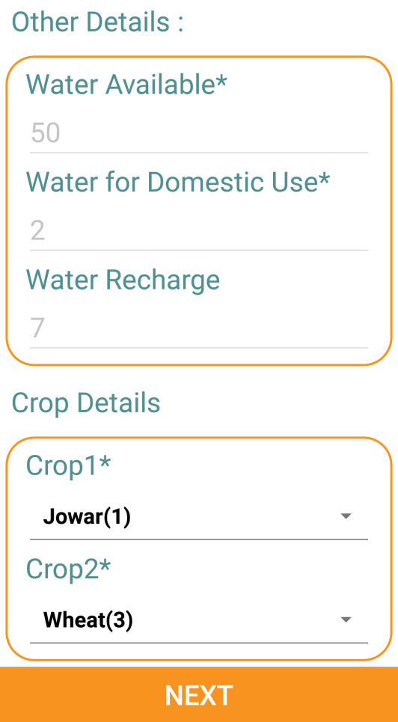
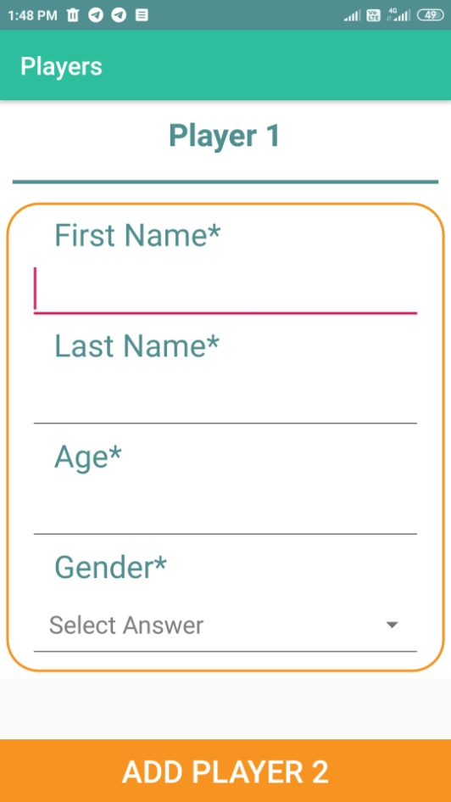
How to use Water Game Tool (Cont.)
Click Start Game to start game entry
Select date and location details from the drop downs provided. | Select crops for the game entry | After crop selection, add 5 game players one by one

Slide 5
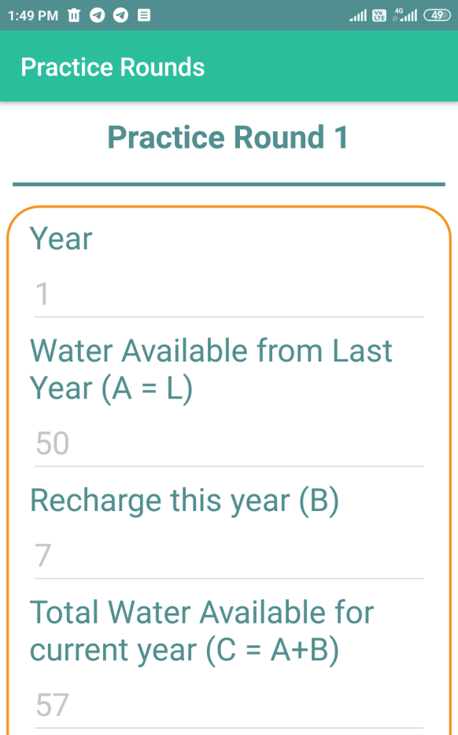
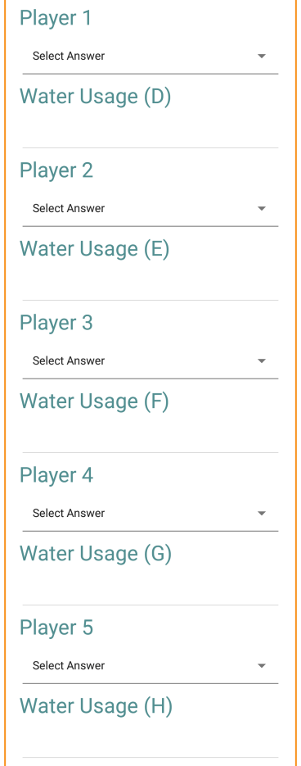
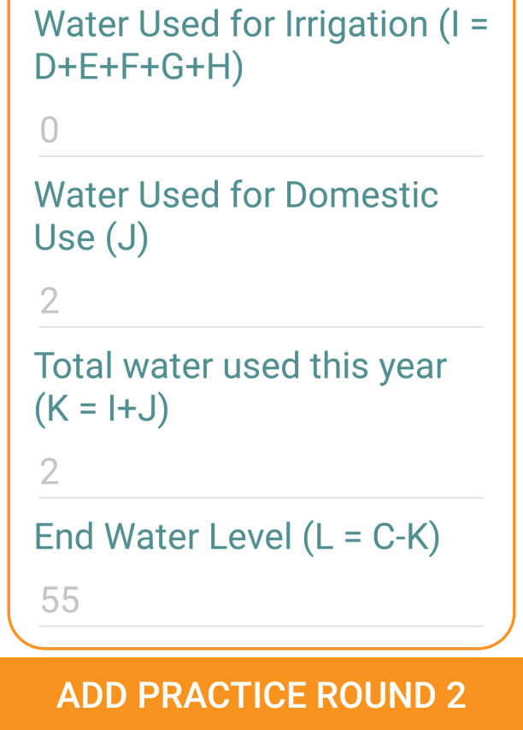
How to use Water Game Tool (Cont.)
After players are added, start practice rounds
Some of the details are pre-populated and non-editable | Select crops for each players | Game will automatically calculate water usage as per selection
Note: Play 2 practice rounds

Slide 6
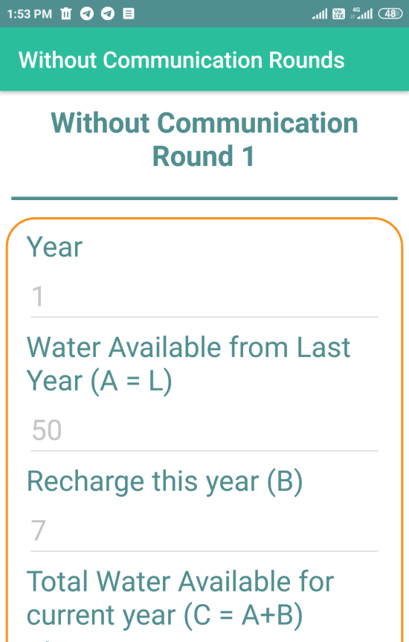
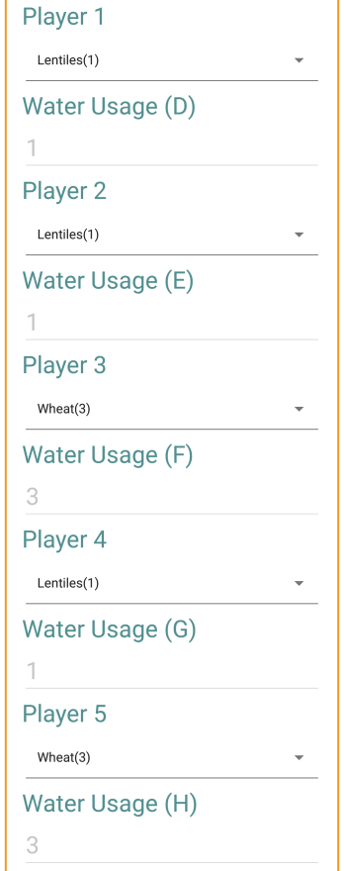
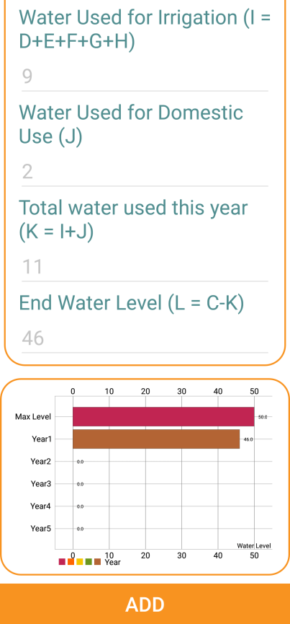
How to use Water Game Tool (Cont.)
After 2 practice rounds are completed, start without communication rounds
Some of the details are pre-populated and non-editable | Select crops for each players | Game will automatically calculate water usage as per selection and generate graph
Note: Without communication rounds can be played till water level reaches 10 or finished manually

Slide 7
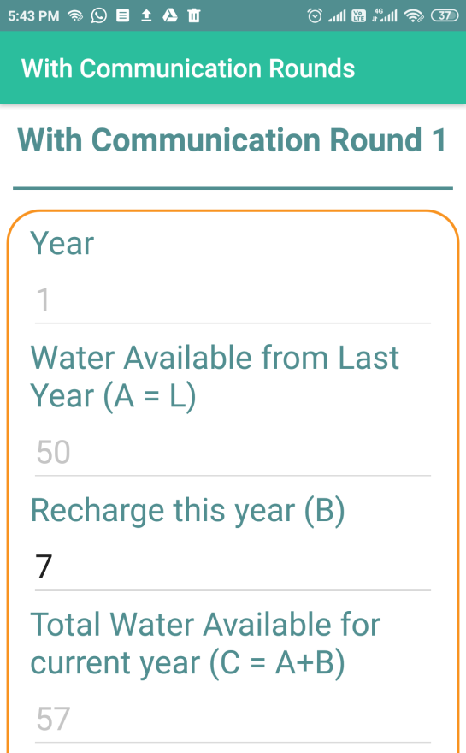
How to use Water Game Tool (Cont.)
After completing without communication rounds, start with communication rounds
Some of the details are pre-populated and non-editable, recharge value is editable | Select crops for each players | Game will automatically calculate water usage as per selection and generate graph
Note: With communication rounds can be played till water level reaches 10 or finished manually after 5 rounds

Slide 8
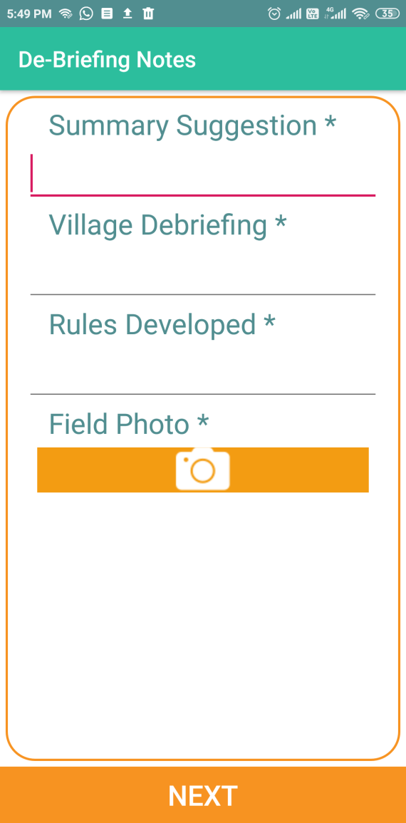
How to use Water Game Tool (Cont.)
After completing with communication rounds, add de-briefing notes and field photo and complete the game entry.

Slide 9
Thank You

